Slide 1

Robotics Team Design Project M Simulated RoboCup Soccer Teams
Supervisor – Dr. Euan McGookin
Team 10

Slide 2
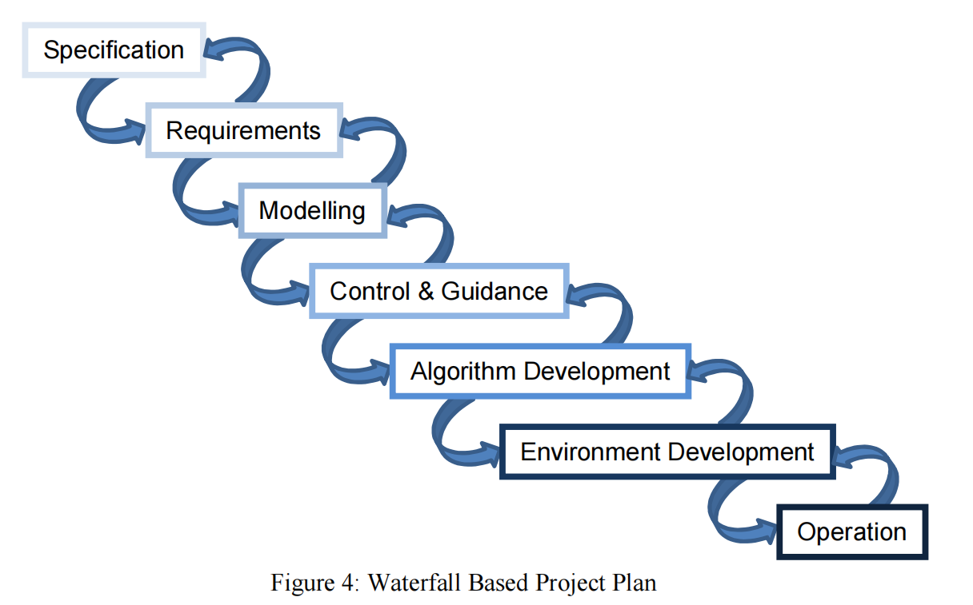
Project Plan

Slide 3
Daily meeting content this week
Week 3 (Group meeting)
Meeting Date: 15/2
Meeting mins: 120mins
Meeting Content:
To summarise the progress of work completed.
Complete the algorithm flowchart design for the control and navigation part
Create a 3D soccer field and import na06 robots and ball
The code that was completed last week was successfully implemented in webots
2. Content that the team is in the process of implementing
Based on a 3D model already realised, figure out the part where we take control of these bots using Matlab
Implementation of 2D algorithms according to the design strategy of the control and navigation section
The project report framework is being built and developed
Learning and implementing stateflow in MATLAB
To-Do List
Divide the work the in next week.

Slide 4
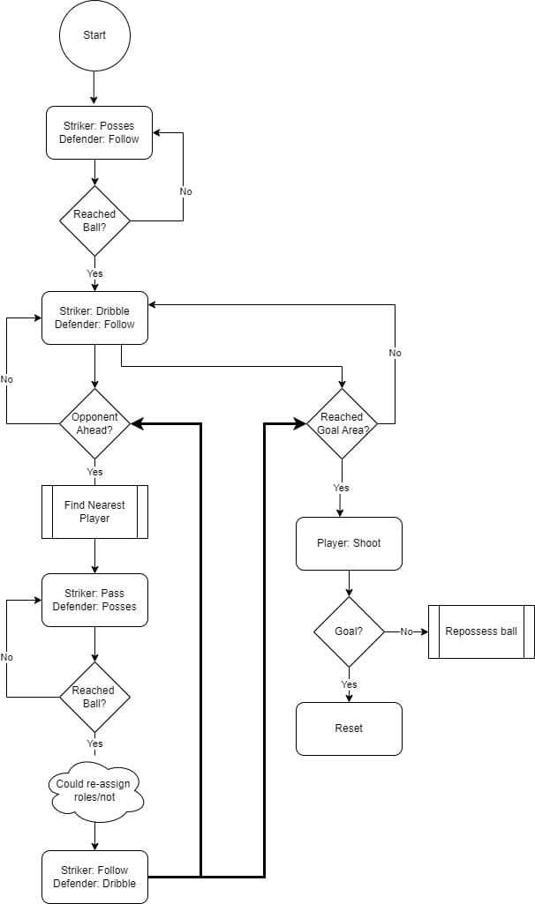
State flow block diagram
Based on an understanding of the rules, the general design of requirements and the design of control strategies is carried out. The design is divided into 4 parts: the main, the striker, the defender, and the goalkeeper.
Each part built the state flow block diagram like the diagram on the right

Slide 5
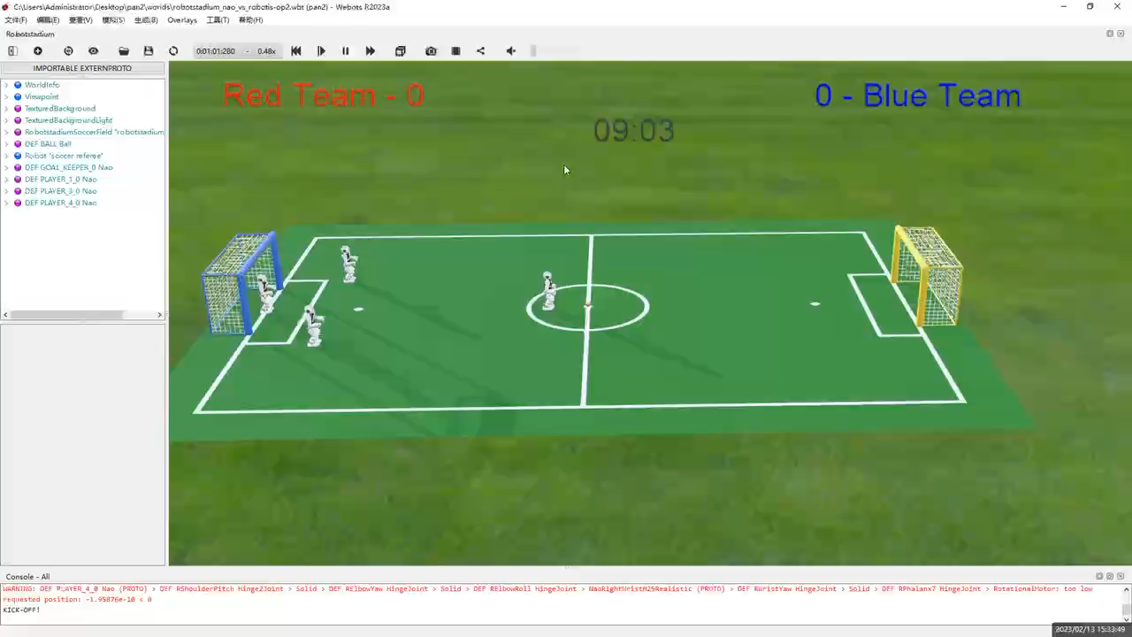
Code implemented in webots

Slide 6
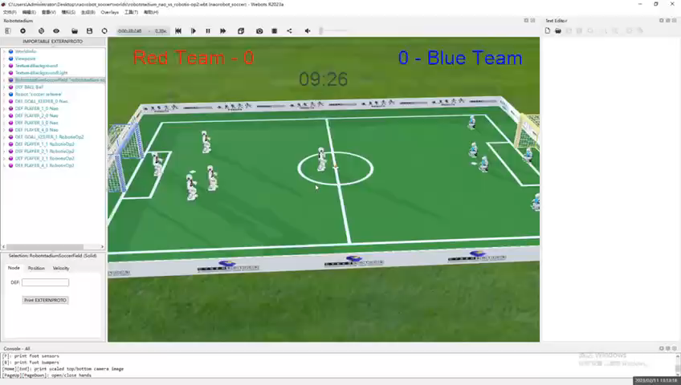
Using control joint packages to defined kick ball

Slide 7
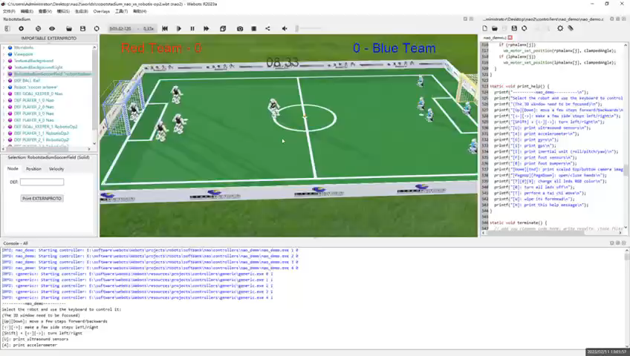
Using control joint packages to defined turn body

Slide 8
Work in progress
Based on a 3D model already realised, we are trying to figure out the part where we take control of these bots using Matlab
We are implementing the code for the 2d ball game step by step according to the flowchart we made (Expect to spend 2-3 weeks)
We are also learning and trying to build a robot football project within MATLAB's stateflow
We are building and developing the project documents and the framework of the project report

Slide 9
Question
Can we use webots ?

Slide 10

Thank you for your time!

